Slide 1

Department of Artificial Intelligence and Machine Learning
IntelliData — An Agentic AI Based Data Intelligence & Governance Platform
Kartickeeyaan M [231501074]
Dr. Balamurugan N M
Lokesh R [231501087]
Mano Prasad V [231501095]

Slide 2
Problem Statement and Motivation
Real-world datasets are messy: missing values, duplicates, outliers, and inconsistent types must be handled before any analysis or ML.
Manual profiling, cleaning, and EDA is repetitive, time-consuming, and hard to reproduce or audit.
Fully automated tools and LLM assistants may silently change data, claim causation from correlation, or send raw records to external APIs, with no human control or traceability.
Need: A governed, agent-orchestrated platform that profiles, scores, cleans, and analyzes data, generates AI insights, and keeps humans in control with versioning and a full audit trail.

Slide 3
User and Stakeholder Analysis
Data Analysts / Scientists – Quickly profile, clean, and explore datasets through explainable, reviewable steps.
Business Users / Decision Makers – Get plain-language summaries and hypotheses without writing code.
Students / Researchers – Learn structured, reproducible data preparation with full traceability.
Expected Outcome
An analysis-ready, versioned dataset with quality scores, EDA charts, ML-readiness diagnosis, human-reviewed AI insights, and an HTML governance report with the complete audit trail.

Slide 4
Proposed agentic AI solution
IntelliData is a multi-agent, governed AI platform that automates data intelligence workflows.
Supervisor Agent – Orchestrates all agent transitions and halts at human approval checkpoints.
Intake Agent – Inspects schema, empty columns, identifier columns, and date-like strings (read-only).
Quality Agent – Scores completeness, duplicates, type consistency, and IQR outliers (0–100).
Cleaning Planner Agent – Proposes risk-rated (low/medium/high) cleaning actions; never auto-executes.
Cleaning Executor Agent – Applies only approved proposals and commits new dataset versions.
Visualization Agent – Recommends semantically safe charts (never sums ratings, %, or IDs).
ML Readiness Agent – Checks target leakage, class imbalance, scaling, and encoding needs.
Insight Agent – Generates hypotheses with confidence levels; no causal claims.
Report Agent – Compiles findings and audit trail into an HTML governance report.

Slide 5
Dataset and knowledge source identification
User-Uploaded Datasets
Source: CSV / Excel files uploaded through the Streamlit UI
Validated for file extension and size; sample workspace uses Titanic-Dataset.csv
Derived Statistical Knowledge
Column profiles, cardinality, missing %, quantiles, IQR outliers
Distributions and Pearson correlations for EDA and AI prompts
Governance Knowledge
Approval decisions and cleaning proposals with risk levels
Dataset version graph (v0, v1, v2 …) and immutable audit events

Slide 6
Selection of tools and Framework
Application & Language
Python 3.12 – Core language for agents, workflow, and tools
Streamlit – Multi-page UI, Agent Governance Hub, approval controls
Data Processing & ML
Pandas – Profiling, quality checks, versioned transformations
scikit-learn – ML readiness diagnostics and baseline suggestions
AI Model
Google Gemini API (optional) – Executive summaries and structured hypotheses
Local deterministic fallback – Pearson-based insights when no API key is available

Slide 7
Selection of tools and Framework
Orchestration & Governance
Supervisor + specialized agents – Workflow state machine with approval checkpoints
Tool Registry – Only registered, deterministic tools; unknown tools rejected
Visualization
Plotly – Interactive distributions, correlations, and recommended charts
Testing & Deployment
pytest + Ruff – 20 governance tests, linting, dependency integrity check
Docker + GitHub Actions – Containerized deployment and CI workflow

Slide 8
Agent workflow and Orchestration
Dataset Upload – User uploads a CSV/Excel file or opens the sample workspace
Supervisor Launch – Runs the autonomous pipeline with a max-step limit to prevent loops
Intake & Quality – Schema inspection, then quality scoring (completeness, duplicates, outliers)
Cleaning Planning – Risk-rated proposals created; workflow pauses for approval
Human Approval – User approves, edits, or rejects each cleaning proposal
Execution – Executor applies only approved proposals and creates version v1, v2 …
Downstream Intelligence – Visualization, ML readiness, then AI business insights
Review & Export – Human reviews insights, authorizes export, Report Agent packages results

Slide 9
Governed Tool Registry
Registered Tools – 14 tools (e.g., validate_dataset, assess_quality, run_eda, execute_cleaning)
Unknown Tool Rejection – Unregistered names raise UnregisteredToolError
No Arbitrary Code – Agents never execute LLM-generated code
Approval Gate – execute_cleaning, rollback_cleaning, and export_dataset require approval
Preview Before Execute – preview_cleaning runs in a sandbox before any change
Privacy Boundary – Gemini receives only bounded statistics, zero raw rows; inputs sanitized
Graceful Fallback – Local deterministic mode when GEMINI_API_KEY is absent

Slide 10
Human-in-the-Loop (HITL)
AI Proposals – Planner creates proposals with risk levels; execution blocked while pending
Human Review – User inspects each proposal with a "Why am I seeing this?" explanation
Approve – Accept individually or via batch selection (no blind approve-all)
Edit & Approve – Adjust parameters in a JSON editor (e.g., custom fill value)
Reject – Original data preserved; optional note recorded in the audit log
High-Risk Guard – Outlier capping and column drops need explicit confirmation
Audit & Rollback – Every event logged immutably; one-click rollback to parent version
Export Authorization – Report package generated only after final human approval

Slide 11
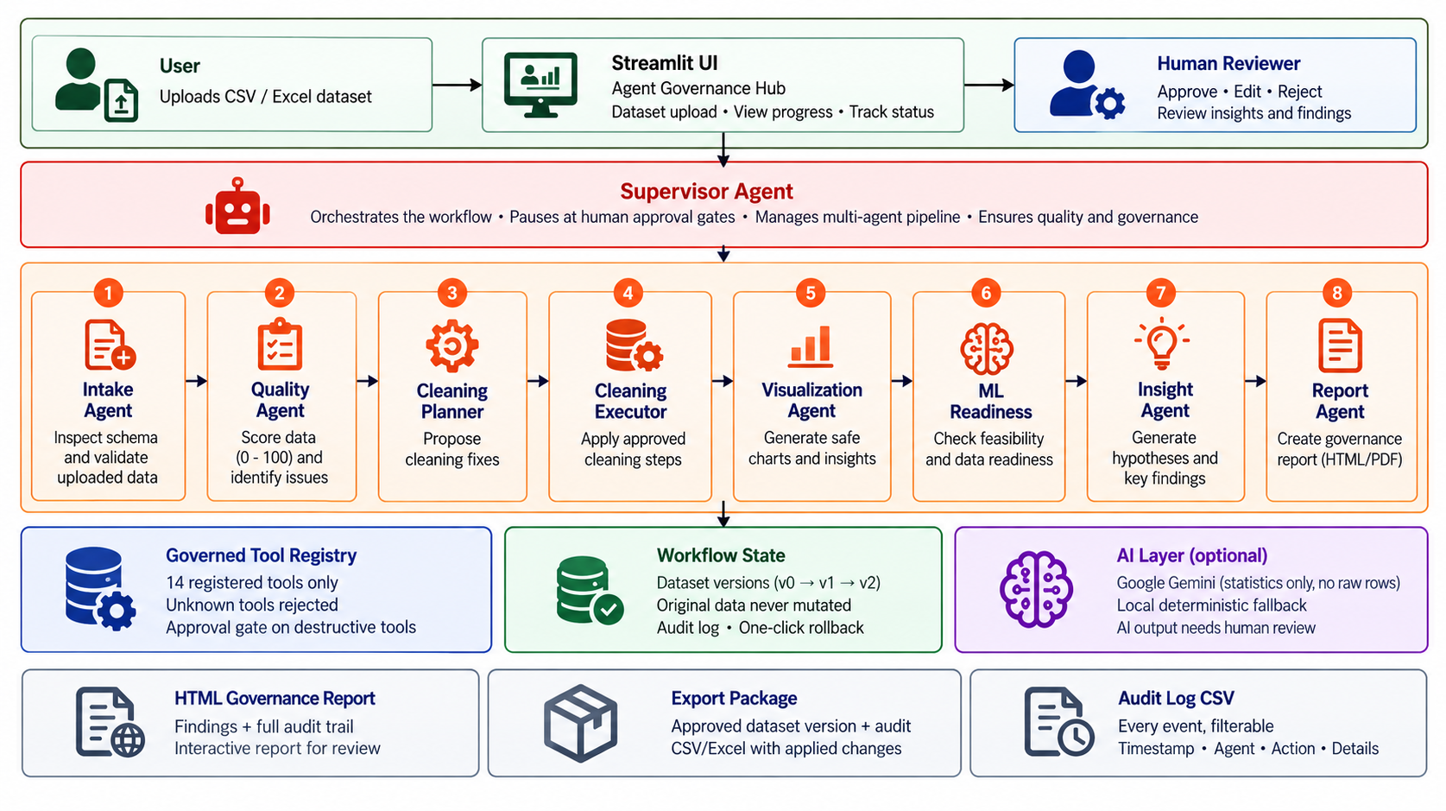
Architecture Diagram

Slide 12
Project plan and milestones
Phase 1–2: Project setup, config, logging; dataset upload & validation
Phase 3–4: Data profiling and data quality scoring
Phase 5: Intelligent cleaning engine
Phase 6–7: Exploratory data analysis and visualization dashboard
Phase 8–9: Gemini AI service layer, AI cleaning explanations, executive summary
Phase 10–11: AI business insights, feature engineering, ML readiness & recommendations
Phase 12–13: AI dataset chatbot; PDF/HTML report generation
Phase 14–15: UI polish, deployment, and portfolio wrap-up

Slide 13
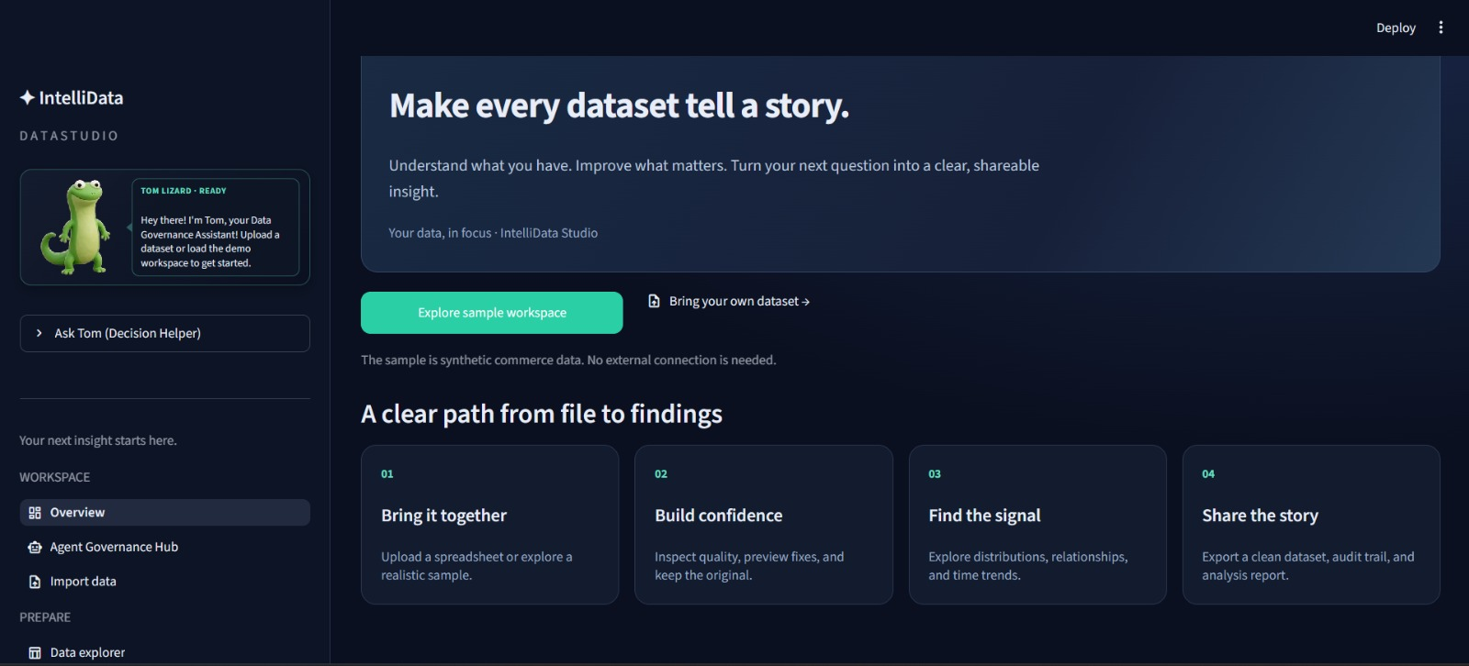
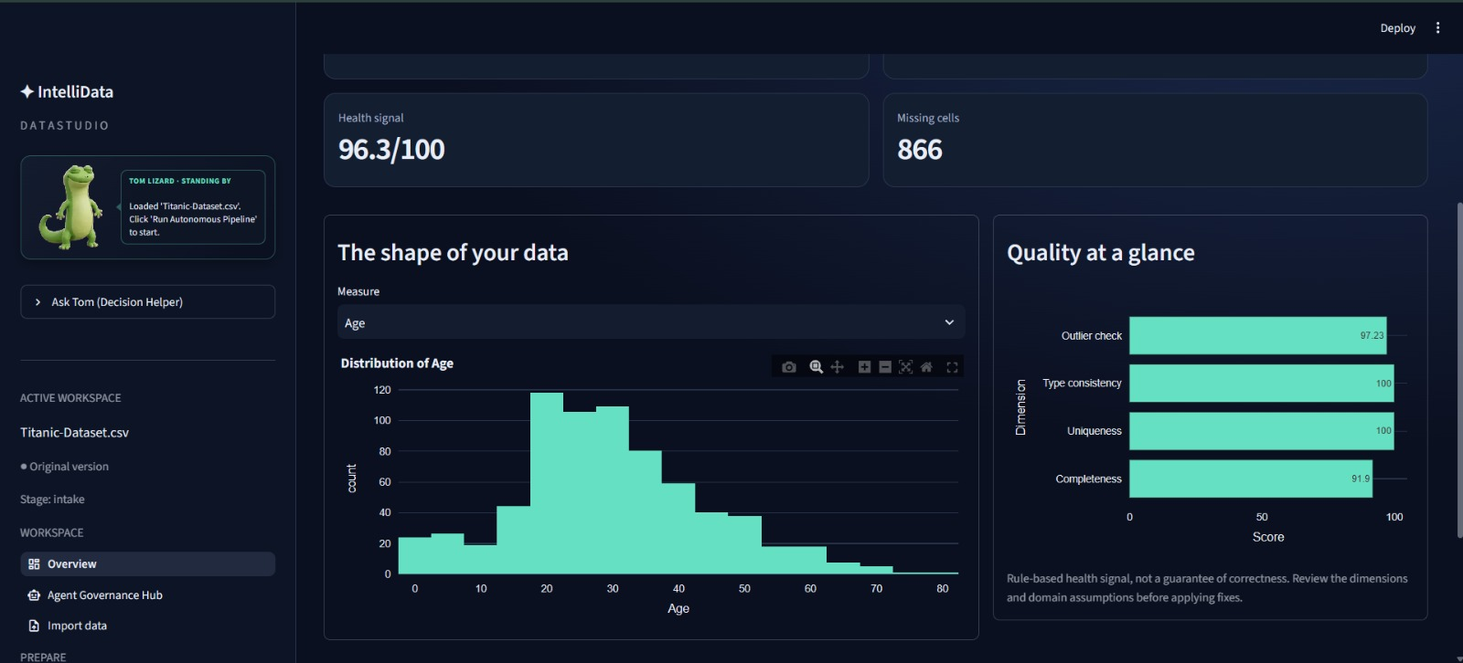
Dashboard and Results

Slide 14
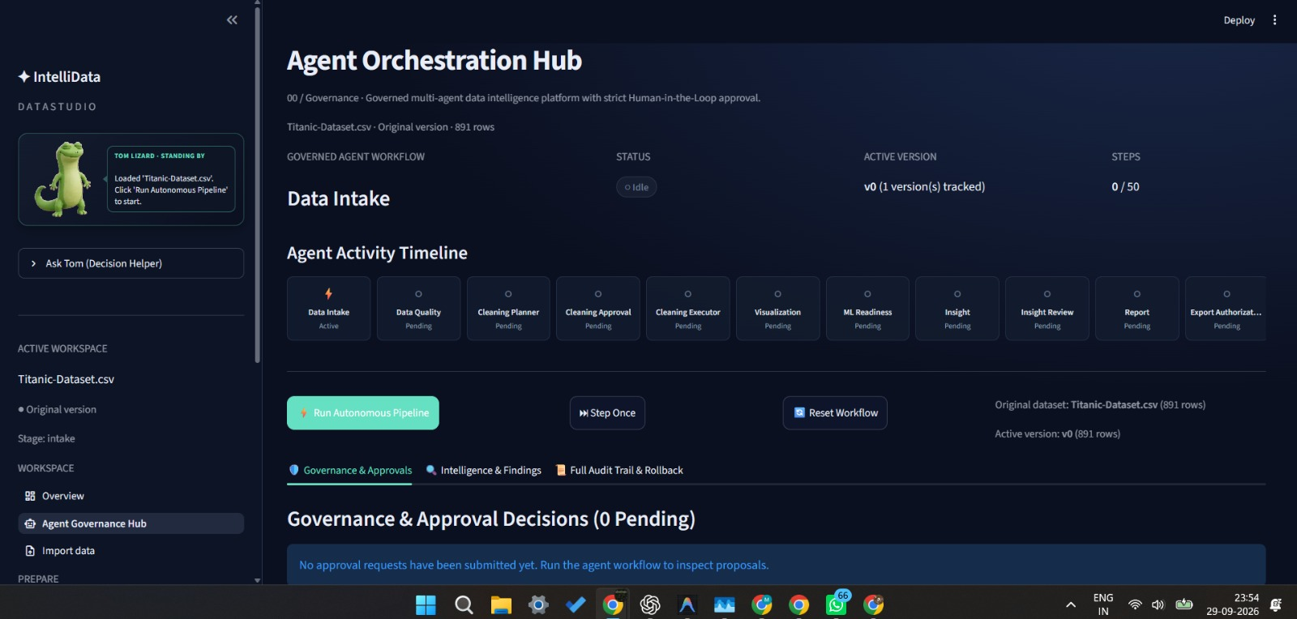
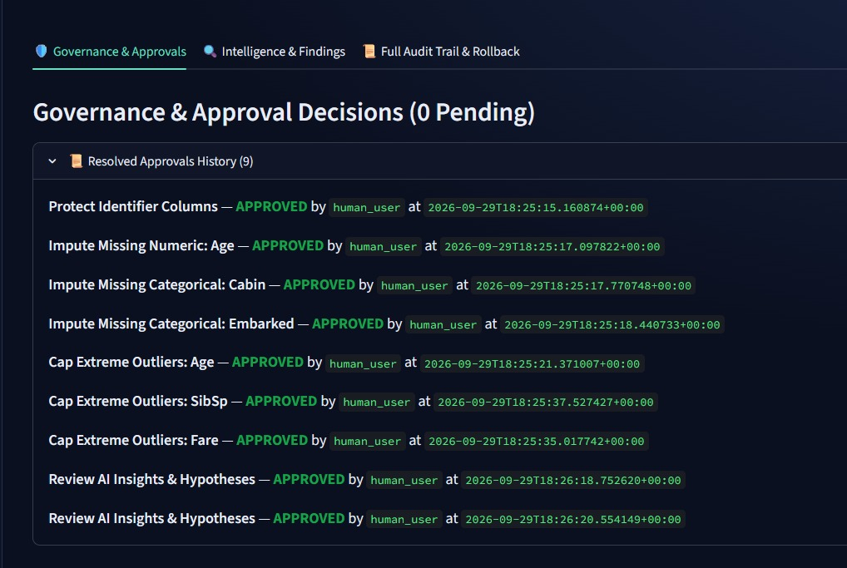
Dashboard and Results

Slide 15
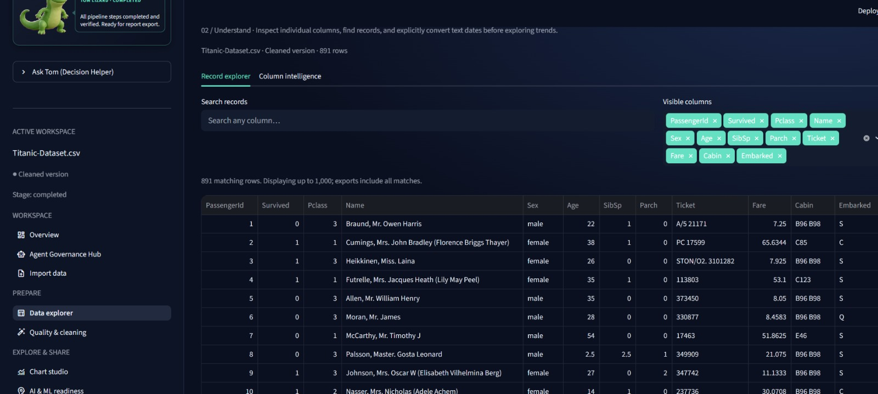
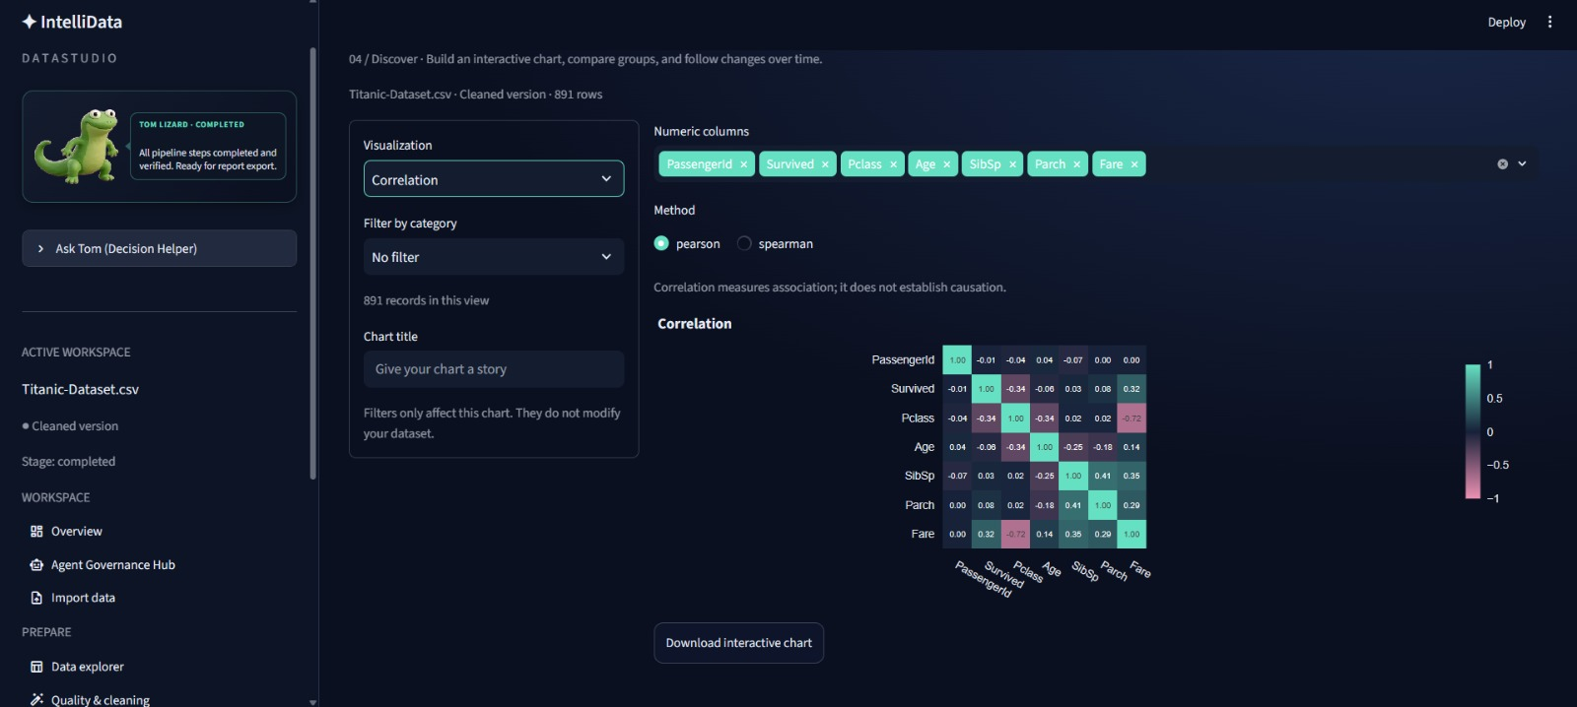
Dashboard and Results

Slide 16
Thank You

